Slide 1
Csye 7280 - User experience design and testing
Assignment 2 – Your own experience in the user’s point of view for a product or service, suggest improvements and moonshot ideas
Notes:
Hello Everyone, I’m Chandrika Bolla.
The service that I chose is Craigslist. It’s an e-commerce company. It has started its business on the Internet in San Fransisco and later spread into the states of USA and now it’s established its position in many countries throughout the world.

Slide 2
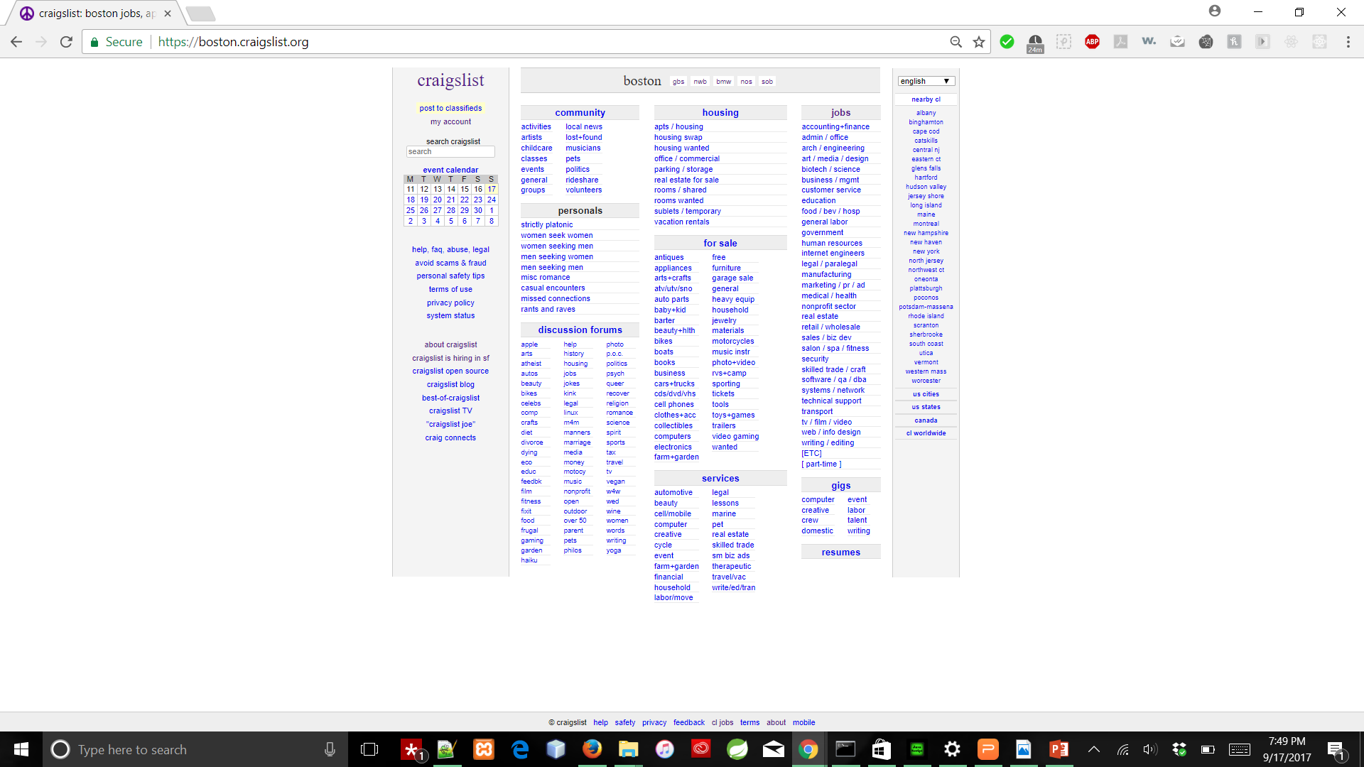
Craigslist https://boston.craigslist.org/
The site serves more than 20 billion page views per month, putting it in 72nd place overall among websites worldwide and 11th place overall among websites in the United States (per Alexa.com on June 28, 2016), with more than 49.4 million unique monthly visitors in the United States alone (per Compete.com on January 8, 2010).
With more than 80 million new classified advertisements each month, Craigslist is the leading classifieds service in any medium. The site receives more than 2 million new job listings each month, making it one of the top job boards in the world.
Notes:
The Craigslist was started in 1995 by Craig Newmark. This website listed here is craigslist for Boston. Craigslist has different websites for each city in the USA and other countries.
This is a screenshot of the Boston Craigslist homepage now.

Slide 3
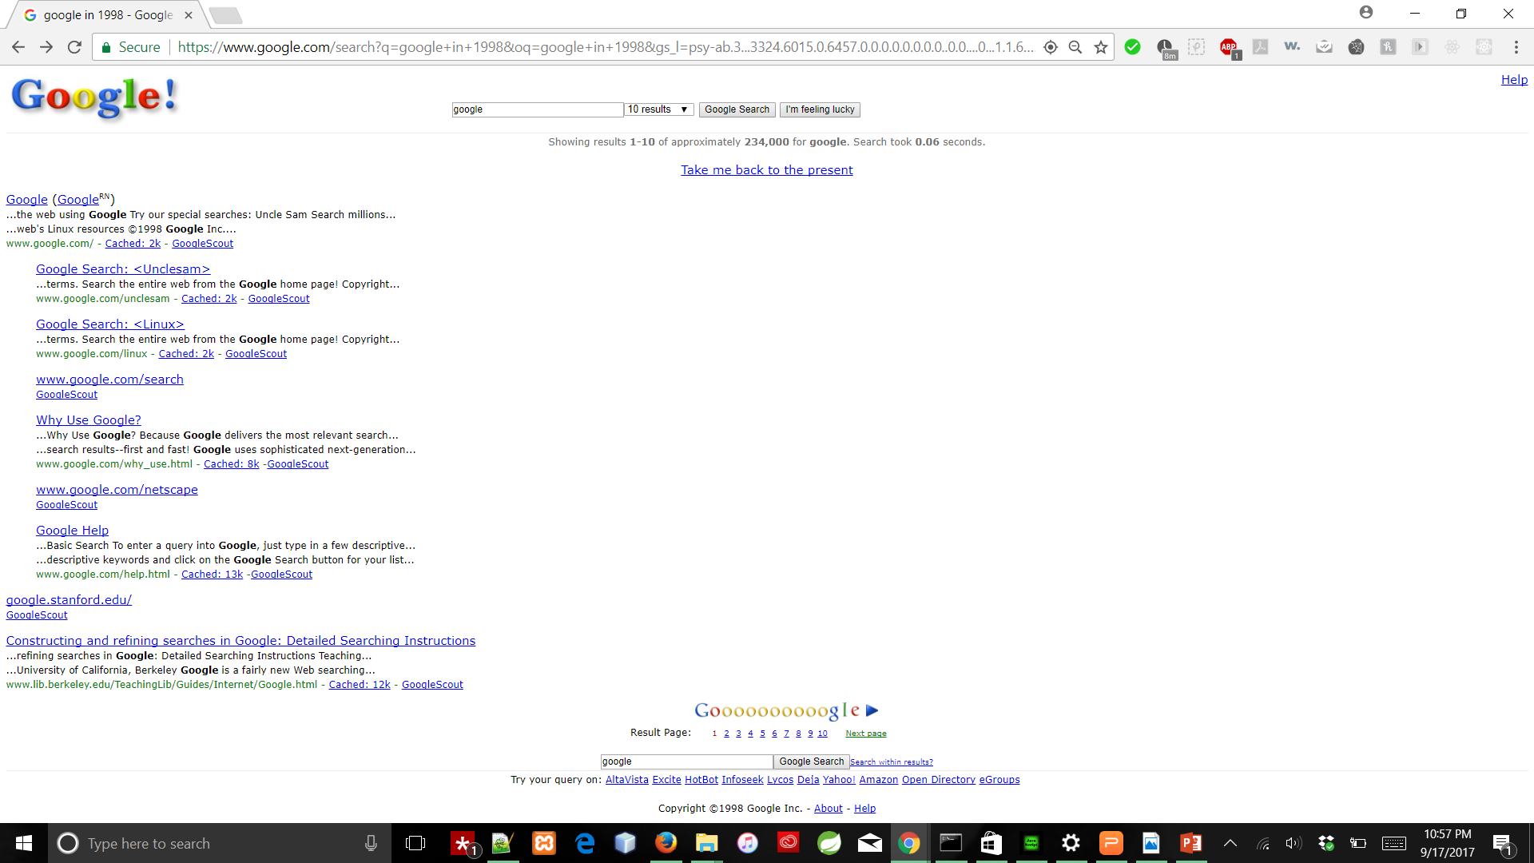
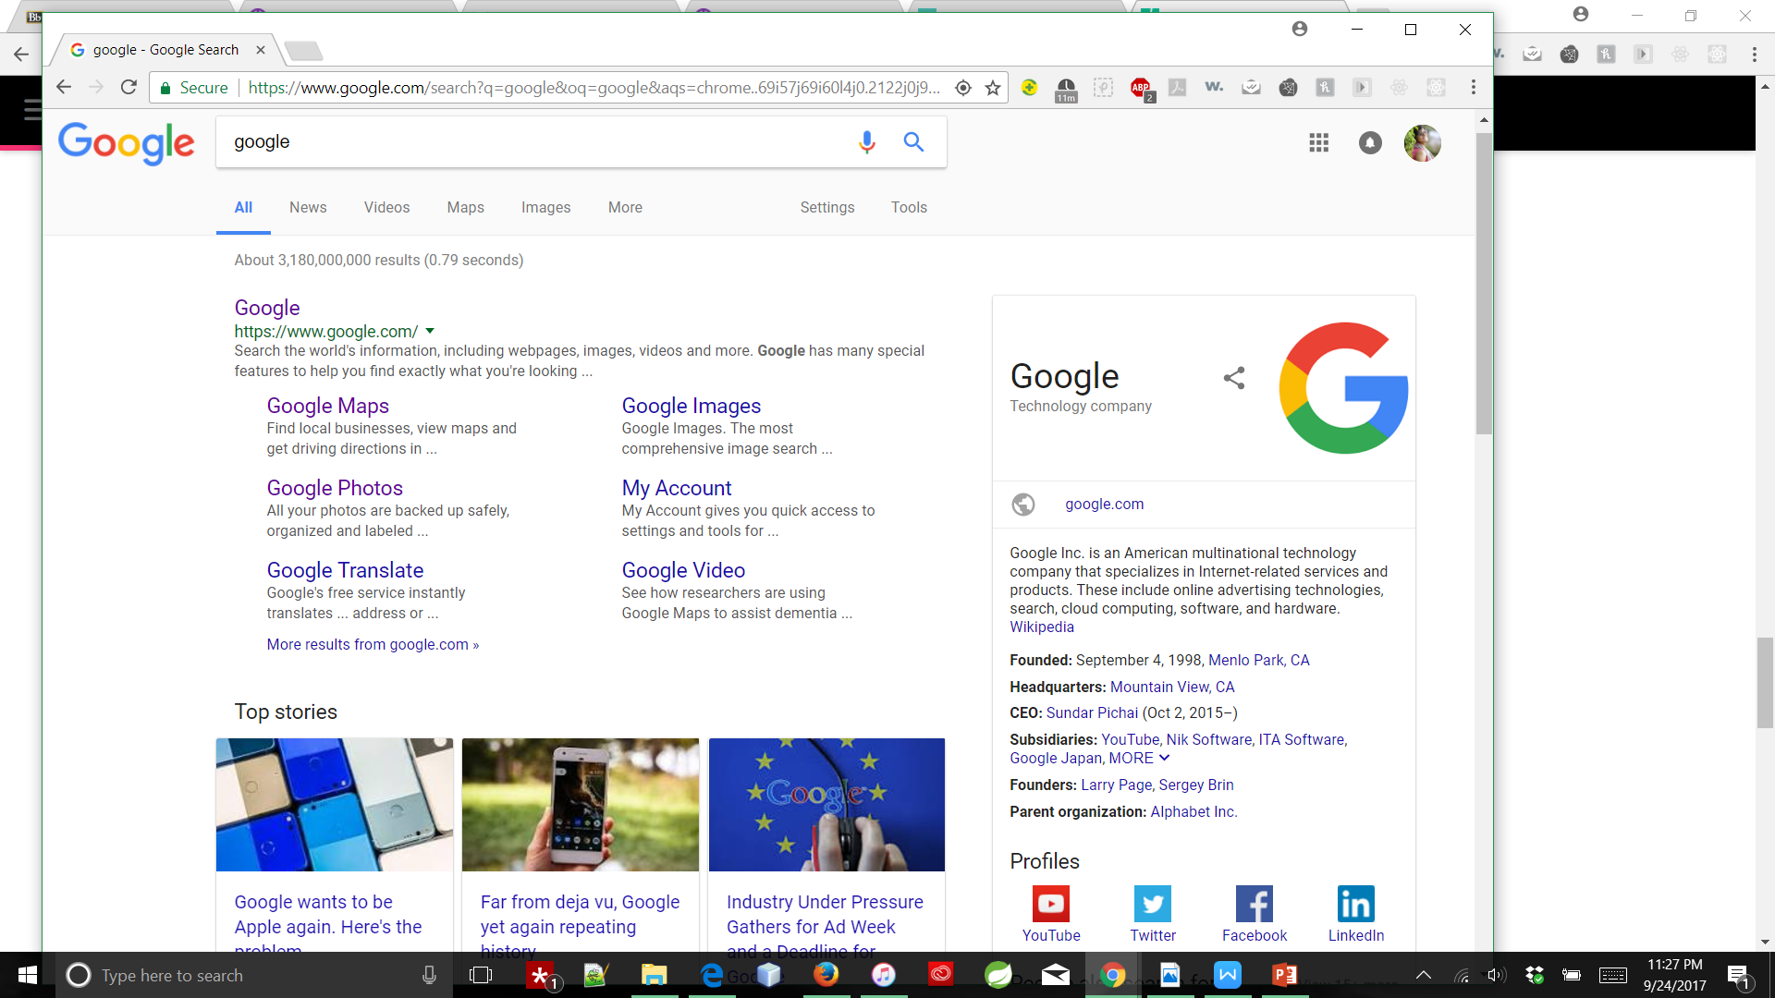
The “then” and “now” of Google:
Notes:
Let’s see how Google search page looked like in the year 1998, when it’s born. And now ,it looks like this.

Slide 4
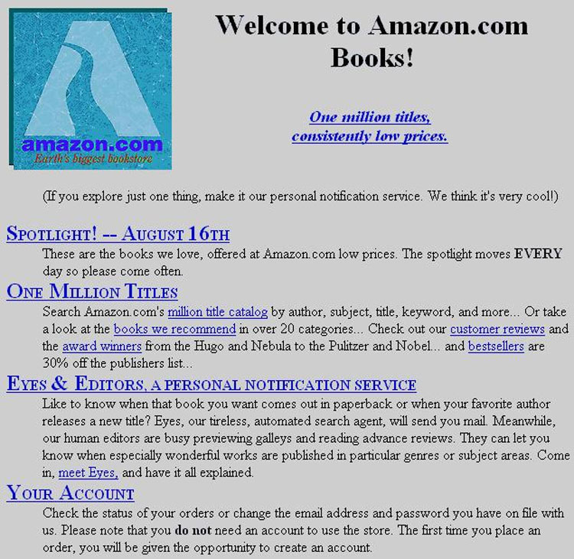
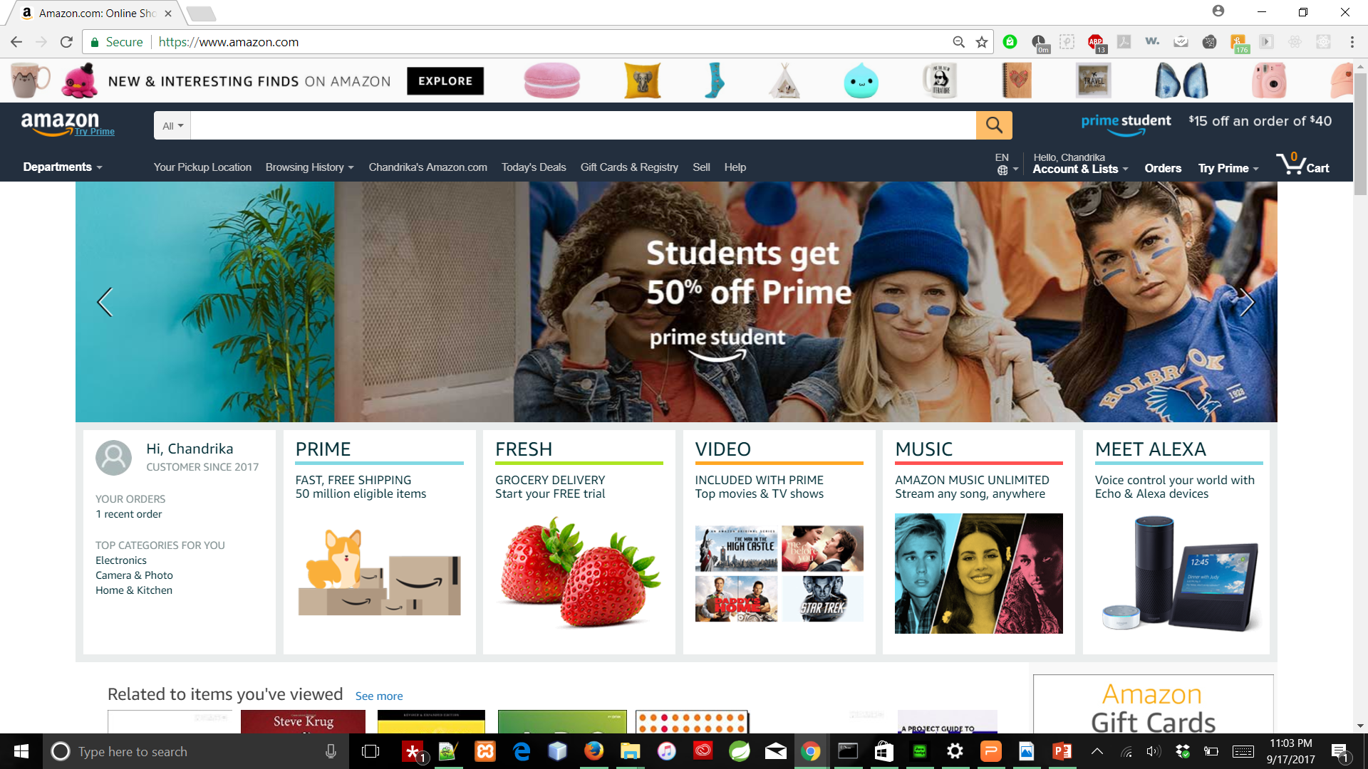
The “then” and “now” of Amazon:
Notes:
This is how the Amazon was in 1994 and in 2017.

Slide 5
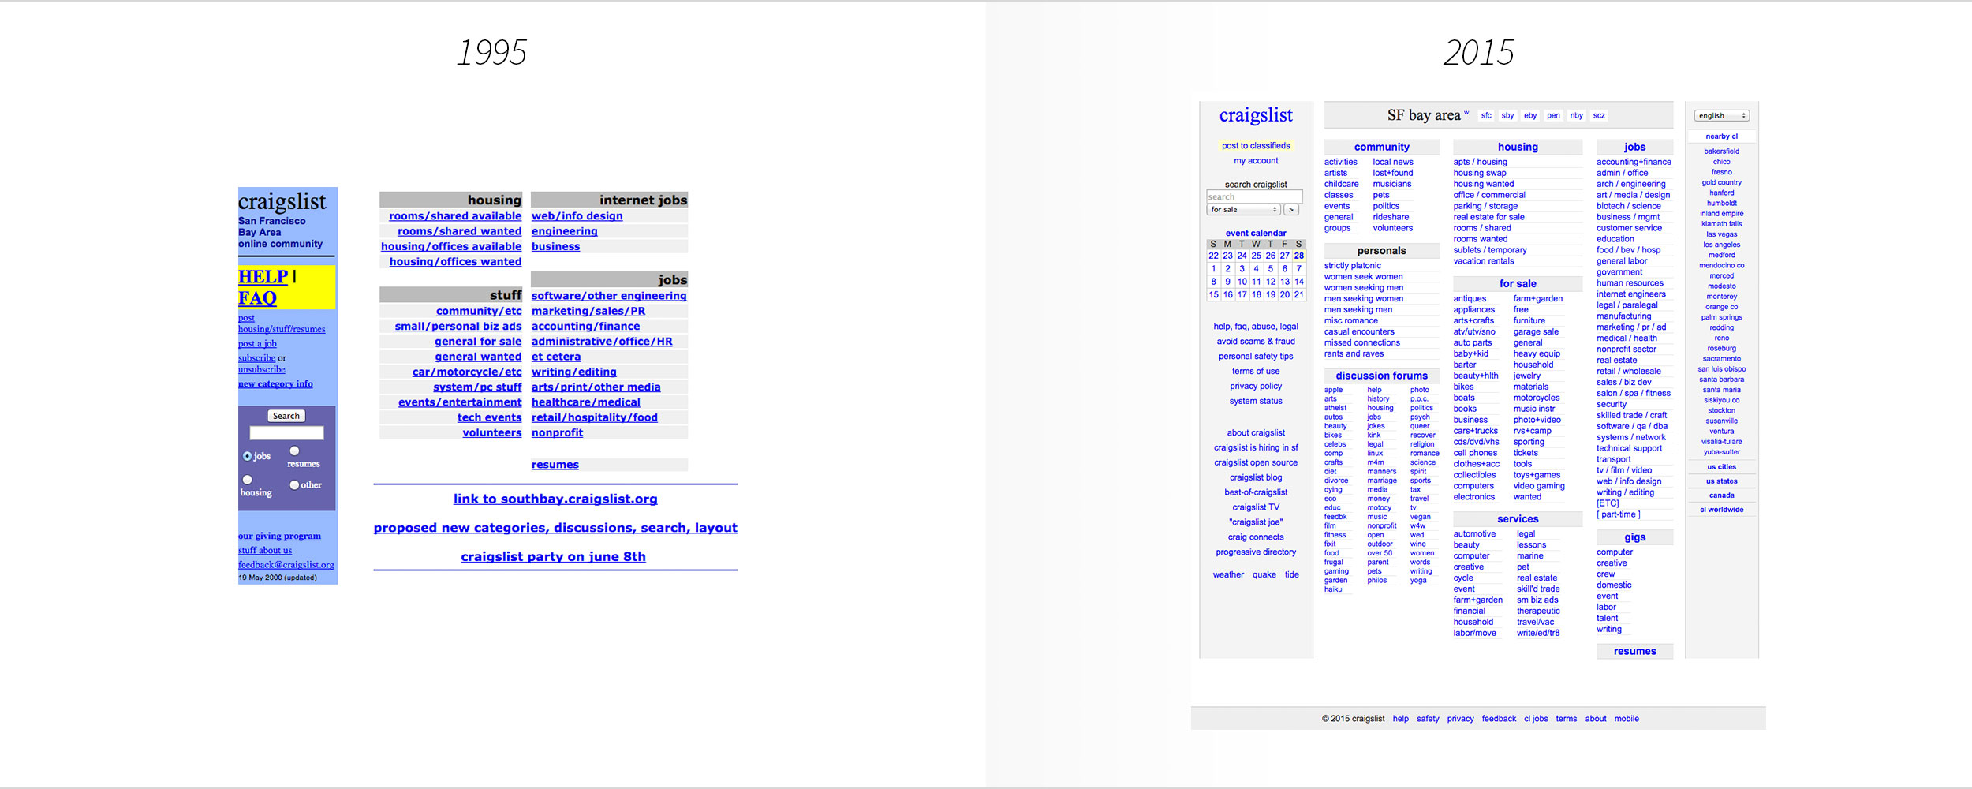
The “then” and “now” of craigslist:
Notes:
This is how Craigslist looked like in 1995 when it was built only for the bay areas of California. And it’s still like this without any images and icons and not even so colorful.
Yet, people use this a lot for their businesses. Other than the visual appeal there must be some other things that made this site popular. Let’s dive more into details to find them out today.

Slide 6
Because, it has everything in one place :
All the services that Amazon,
Eventbrite,
Indeed,
Zillow, ……………………offer
and many more Information and interactive services
Back
Notes:
The target market for Craigslist is people with a lower income that may have outdated computers, browsers and those who are not “internet savvy”.
It’s lightweight when it comes to downloading a page.
It doesn’t have to load many images and icons and doesn’t contain thousands of lines of CSS style.
Craigslist made minor improvements since 2000s, maintaining its number of customers visiting the site.

Slide 7
The features that tickled my fancy ☺
My account,Search bar,Events calendar,For sale,Services,Jobs,Community everything is listed on the homepage
Responsive web design
Listing an image of gallery of total images
Option to save/remove post from the listings generated : customization of webpage, a “+”
Different views i.e., list, thumb, gallery, map
Advanced searching and sorting options
Change the city option in the account settings
Number of hours to keep logged in an account in settings
Titles that reveal abbreviations for anchor elements on the homepage
Notes:
They don’t hide anything. The Amazon might be providing many services and might be selling millions of products. But everything there is hidden in some tabs or dropdown lists. But in here, the categories of products or services are listed on the homepage itself.

Slide 8
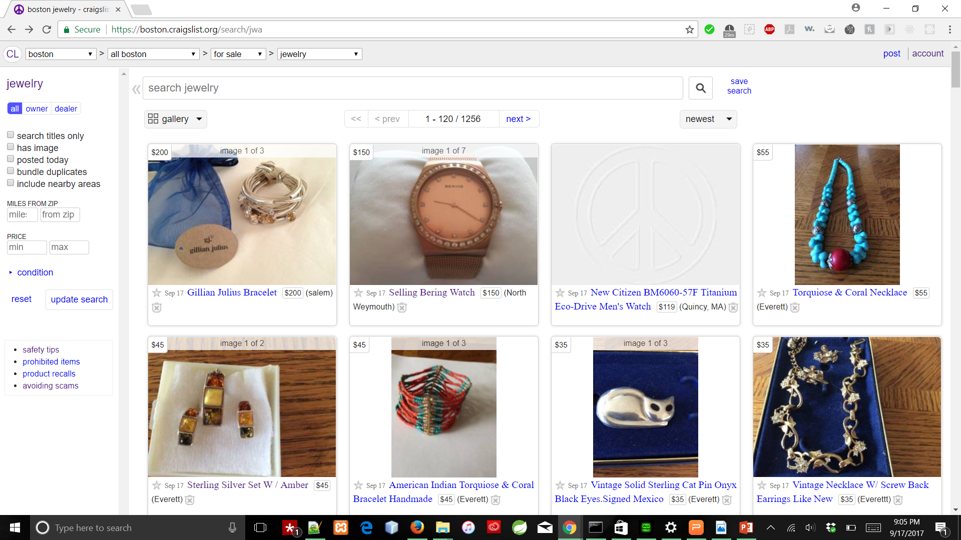
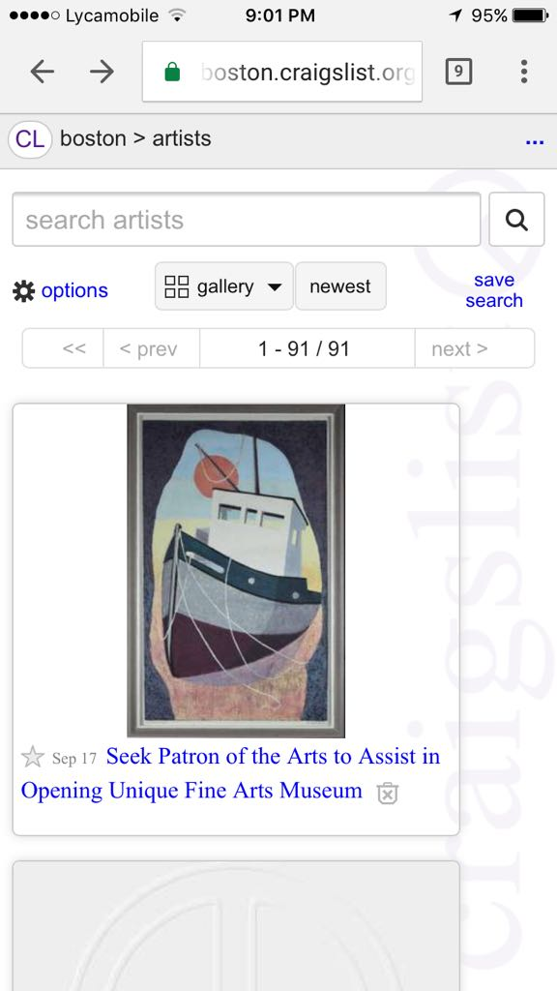
Responsive Web Design:
Back
Notes:
Users don’t have to fool around with zooming and shrinking the text or images on screen. Instead all of the content automatically adjusts to the screen of the device. This makes it easier and more convenient for users to browse through the ads posted.

Slide 9
Listing with an image of gallery of an ad:
Back
Notes:
Every post or ad while in gallery or thumbnail view is presented to the user with the images of the post(if available). If there’s no existing image for an ad, a default Craigslist icon is presented as image.
And in the options to filter, the user can select to see only the posts that have images.

Slide 10
Option to save of remove post :
Back
Notes:
This option of customizing the page viewed by the user by himself is what makes it easy browsing through ads.
Once you delete an ad from view, it’s hidden and unless you unhide it, it won’t bother you by appearing again in the ads list in future.

Slide 11
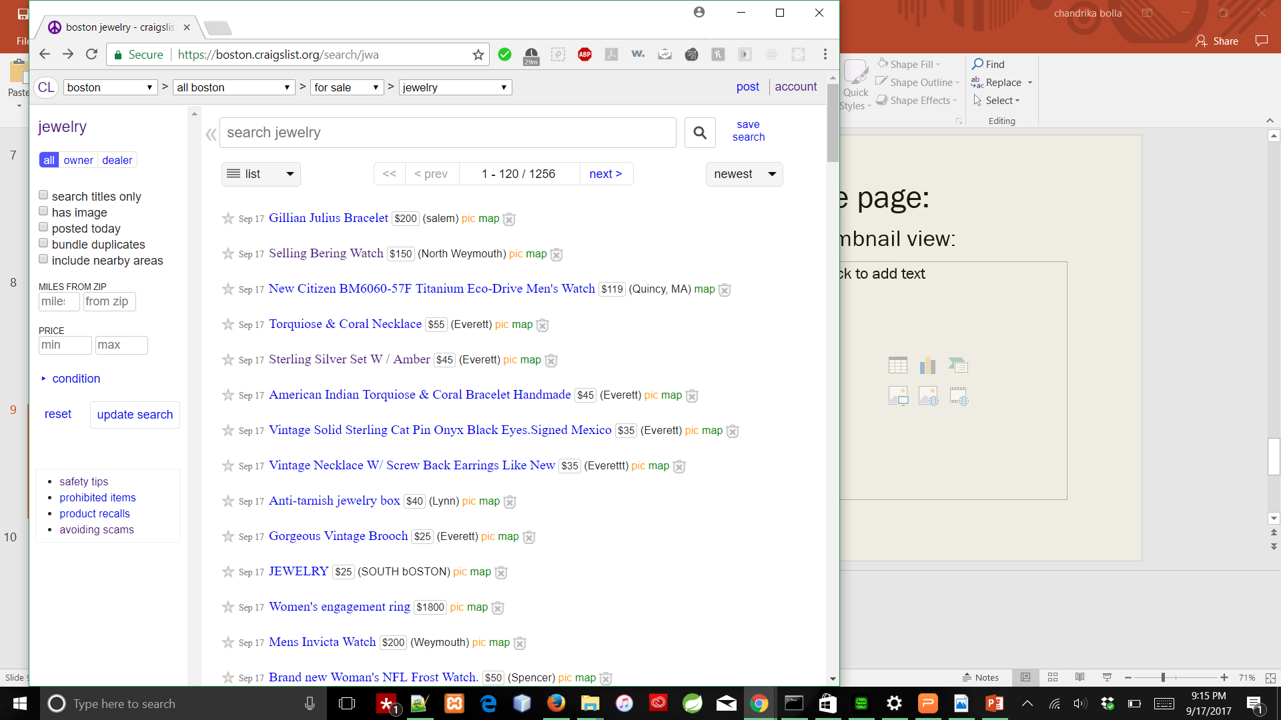
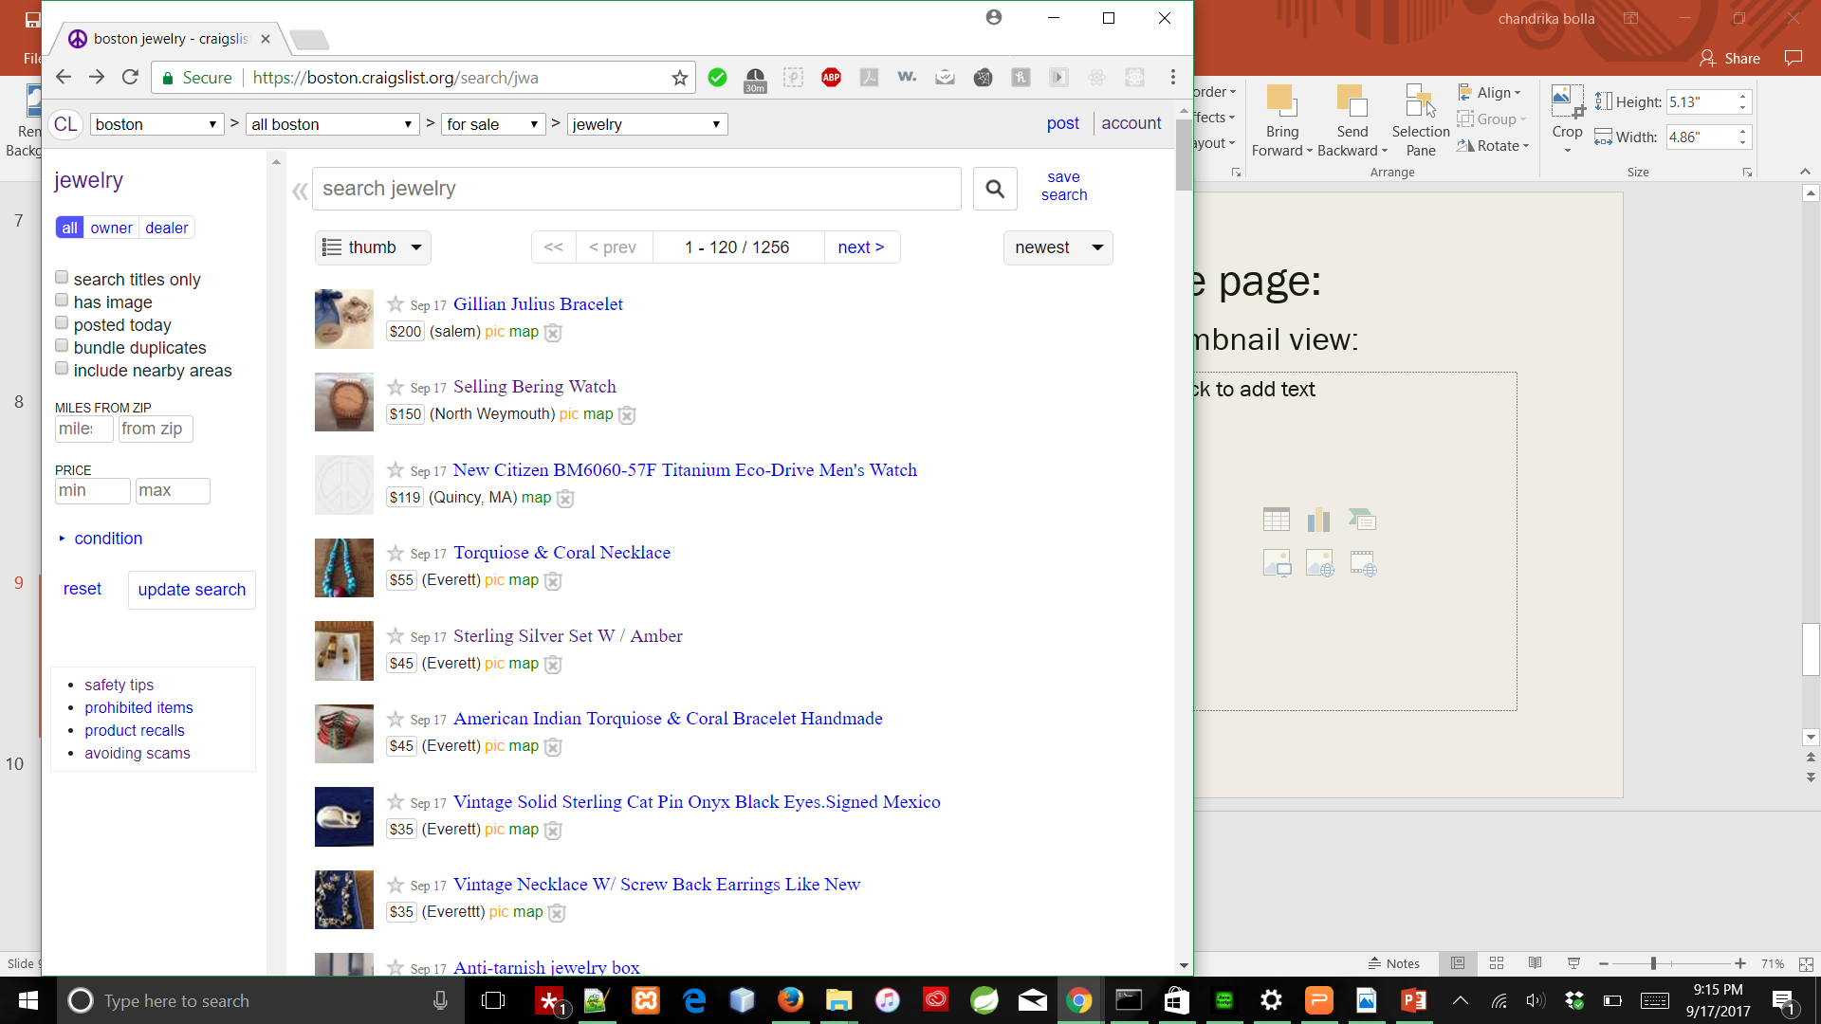
Different views for the same page:
List View:
Thumbnail view:
Back

Slide 12

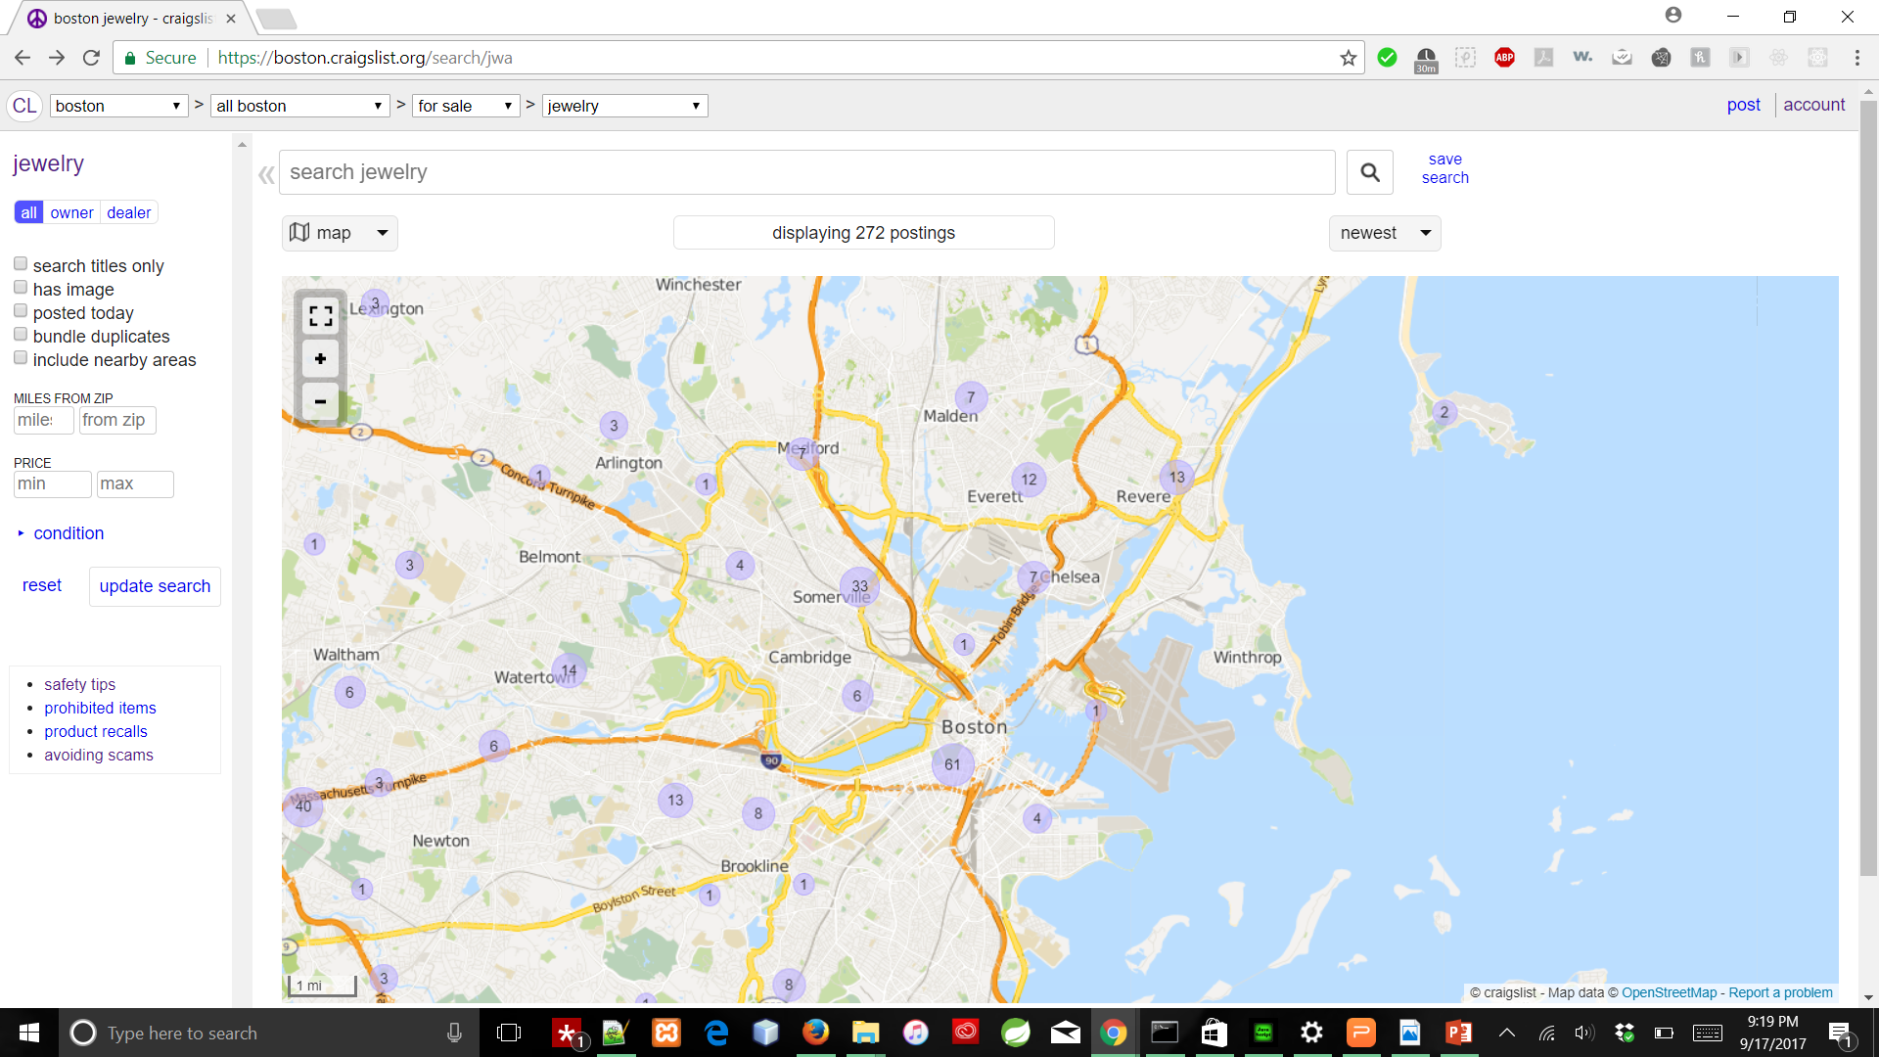
Different views for the same page:
Gallery View
Map View
Back

Slide 13
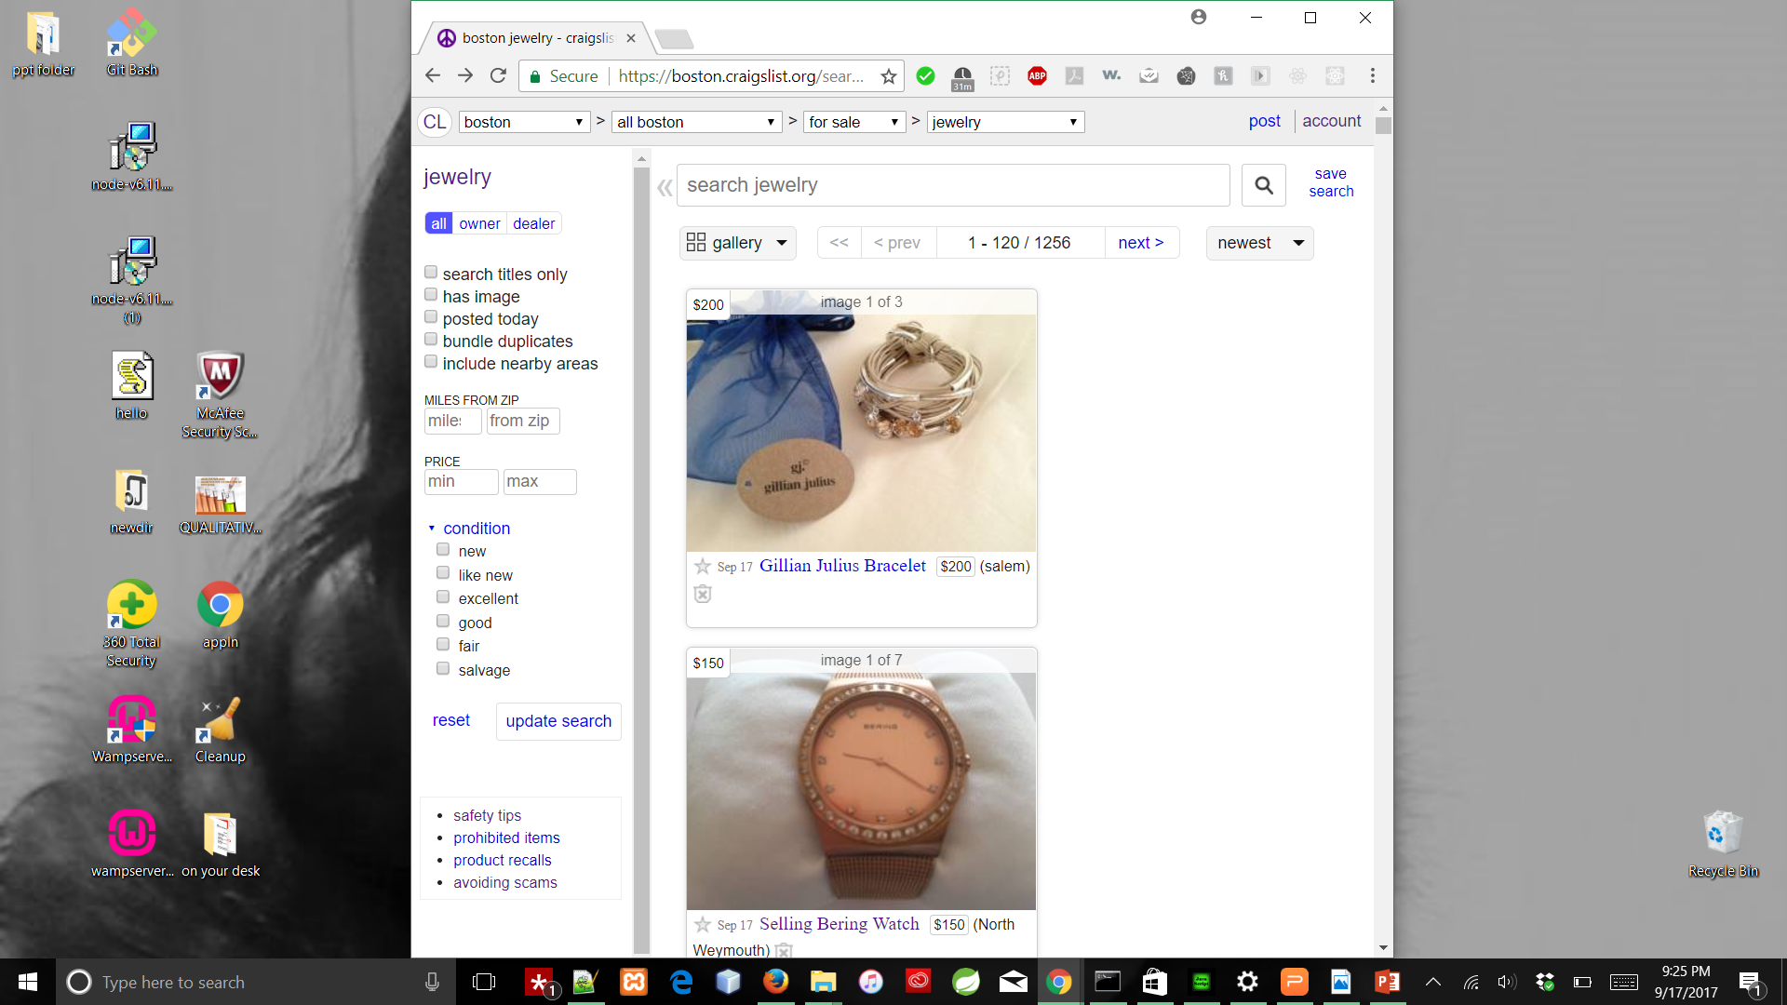
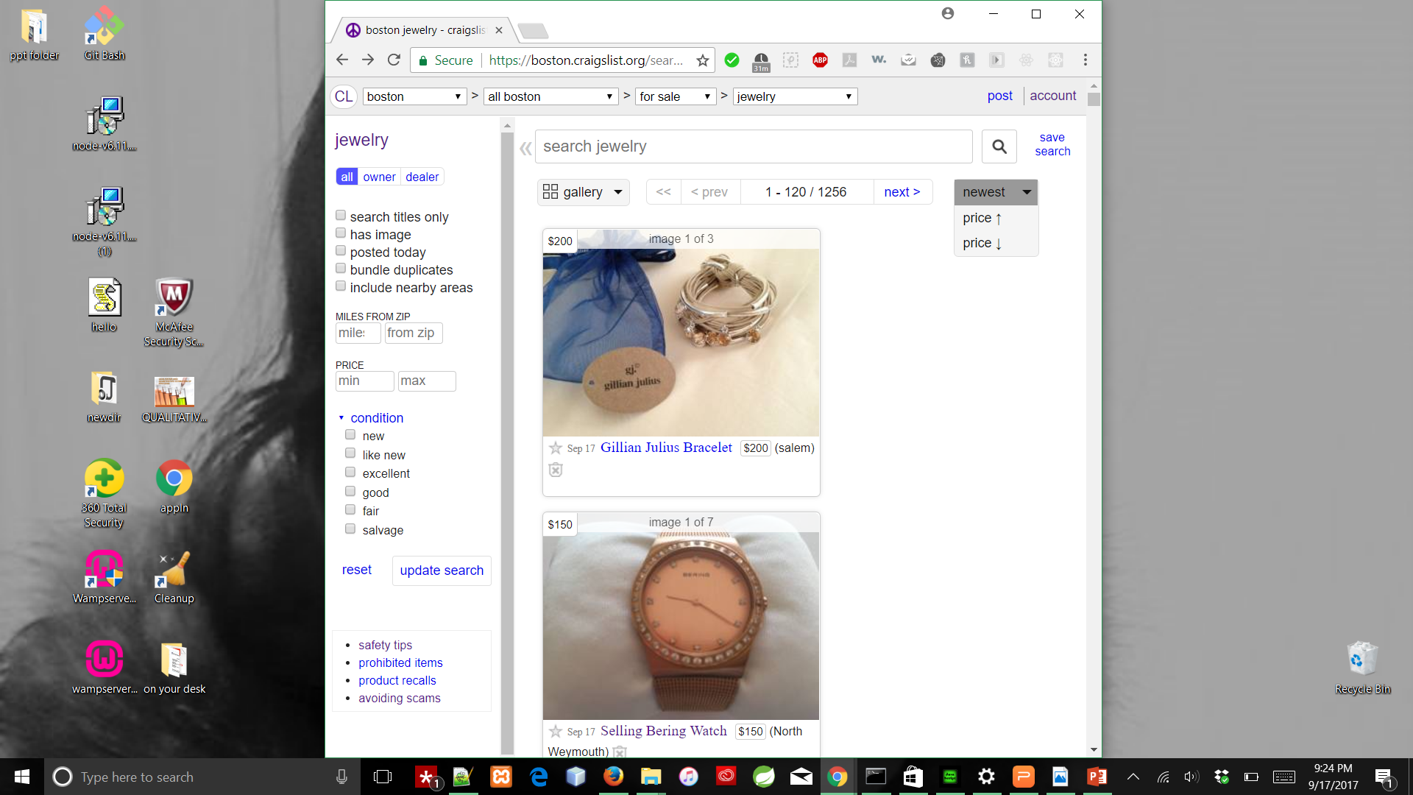
Advanced search and sorting Options:
Back
Back to -
Notes:
This option of customizing the results for the user is the best feature ever.
No one likes to spend browsing posts which they aren’t interested.
What to view first, the sorting option for the listings using factors like time posted and the price , makes it easier and fast to get things done

Slide 14
Features that’re not so impressive 😐
Inconsistency in presenting advertisements
The not so visible subheadings in the advanced search options
Ambiguity in the links provided on homepage
Less use of icons
Color contrast for save post icon
No access to gallery of an ad in the listings page
Links for Previous and Next ad is not so visible
No image or voice search
Password setup instructions are not clear during Signup process
Panel headings in the personal accounts are too small

Slide 15
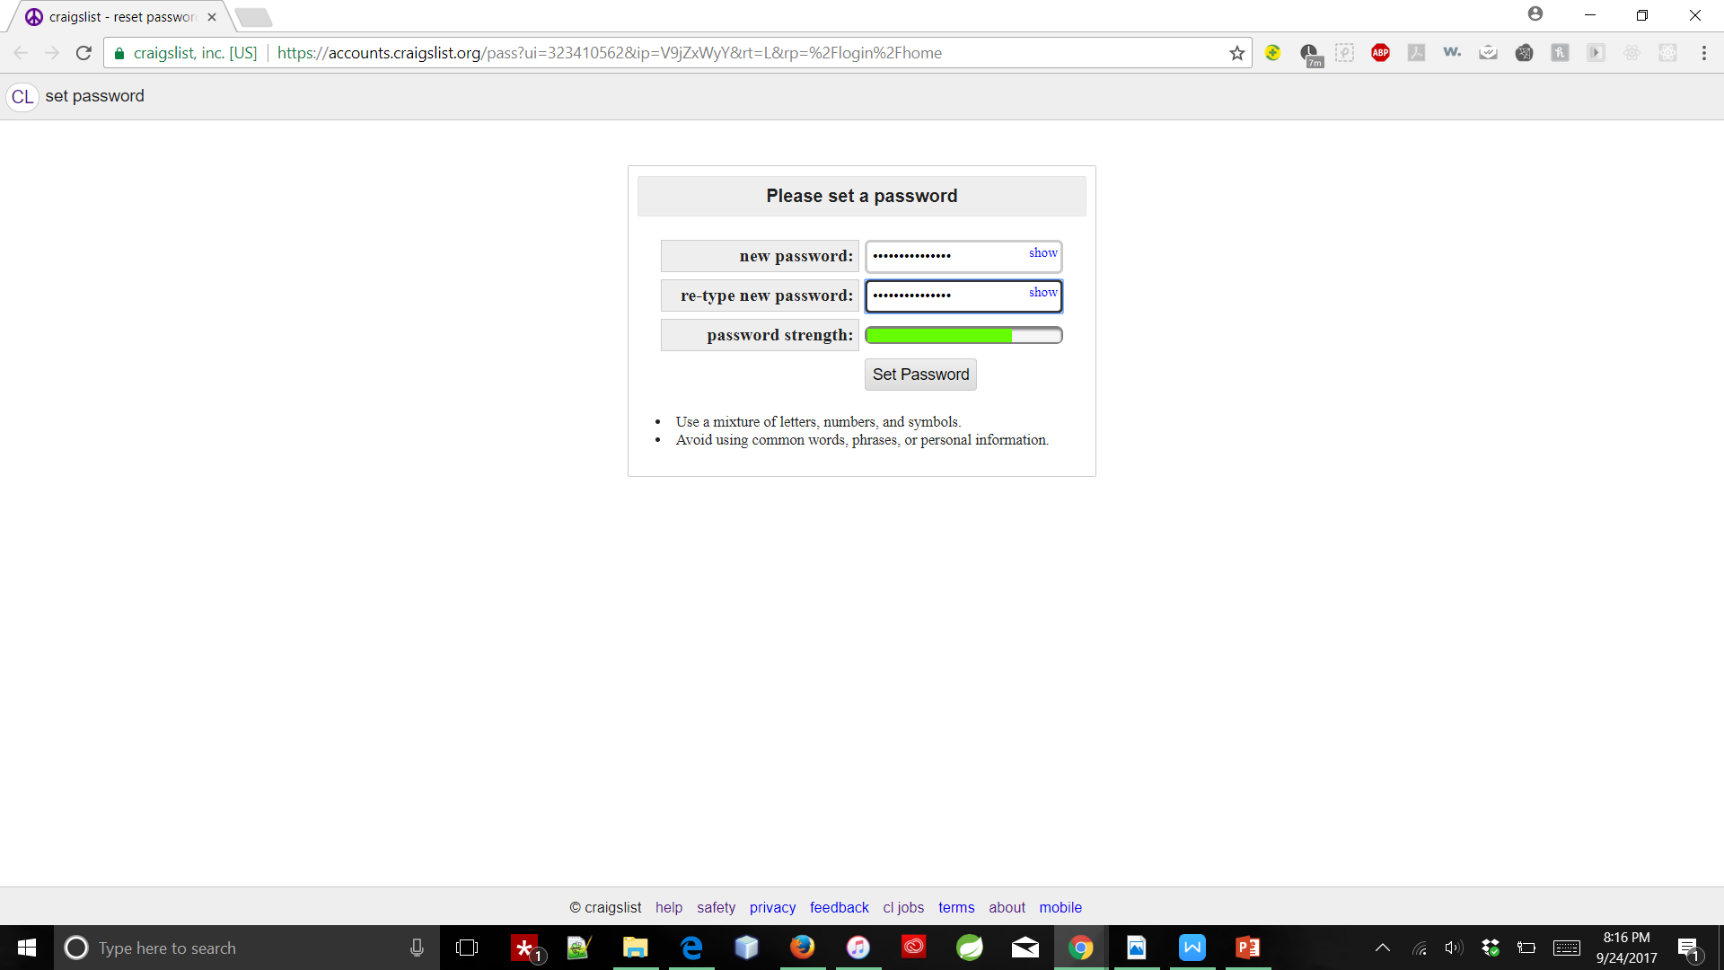
Password Protected Accounts
Back to +
Back to -

Slide 16
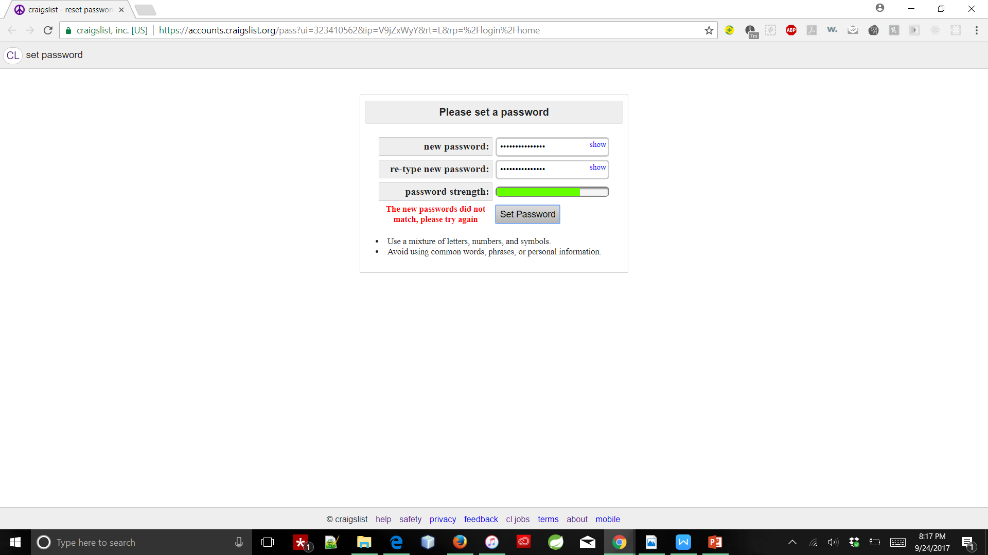
What’s wrong with my input ?!!

Slide 17
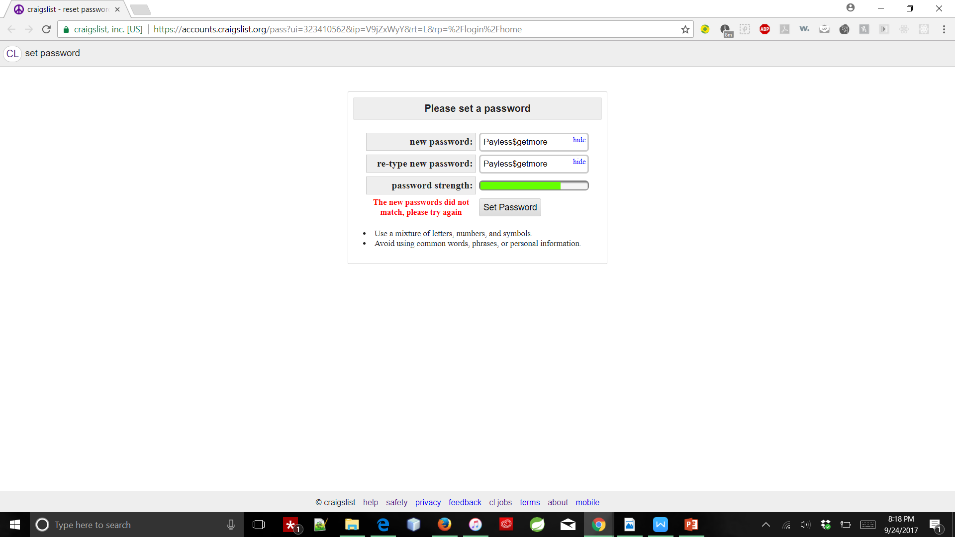
The hide/show option:

Slide 18
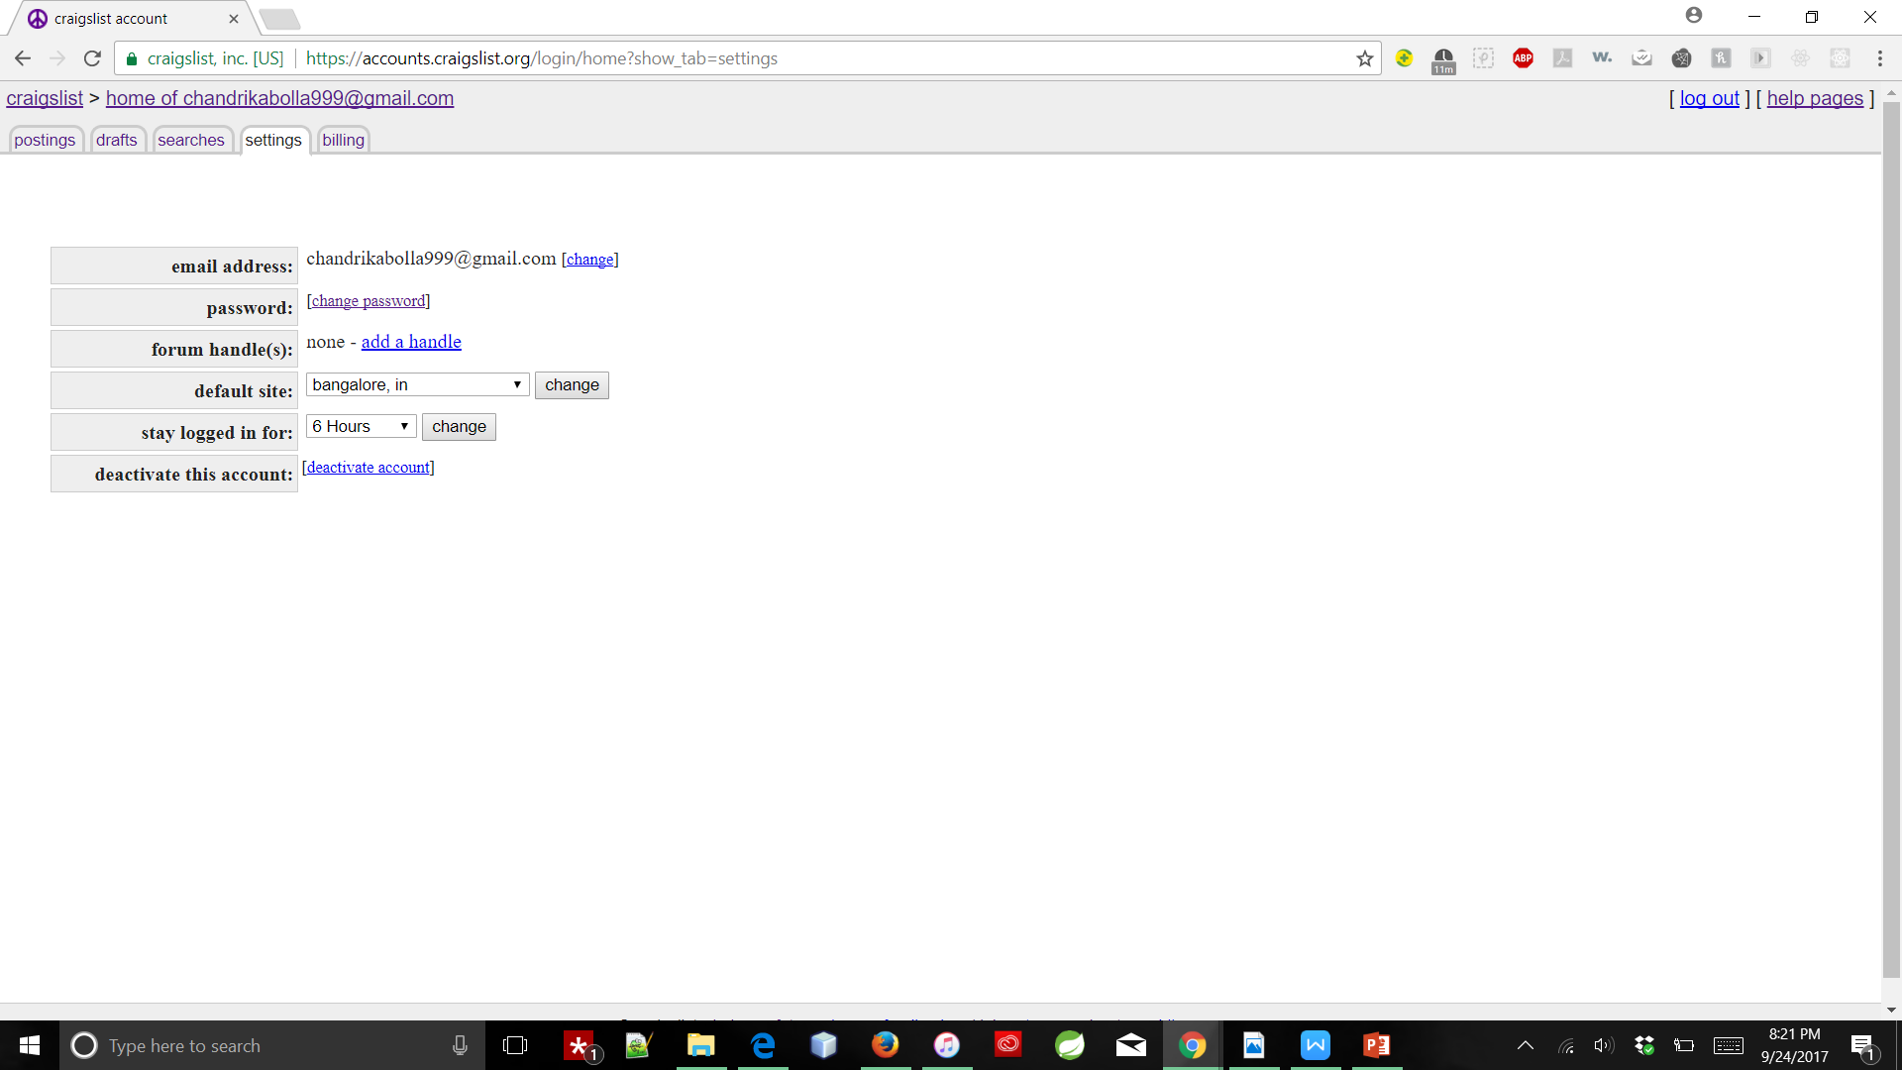
Default site change, Keep me logged in for:
Back to +
Back to -

Slide 19
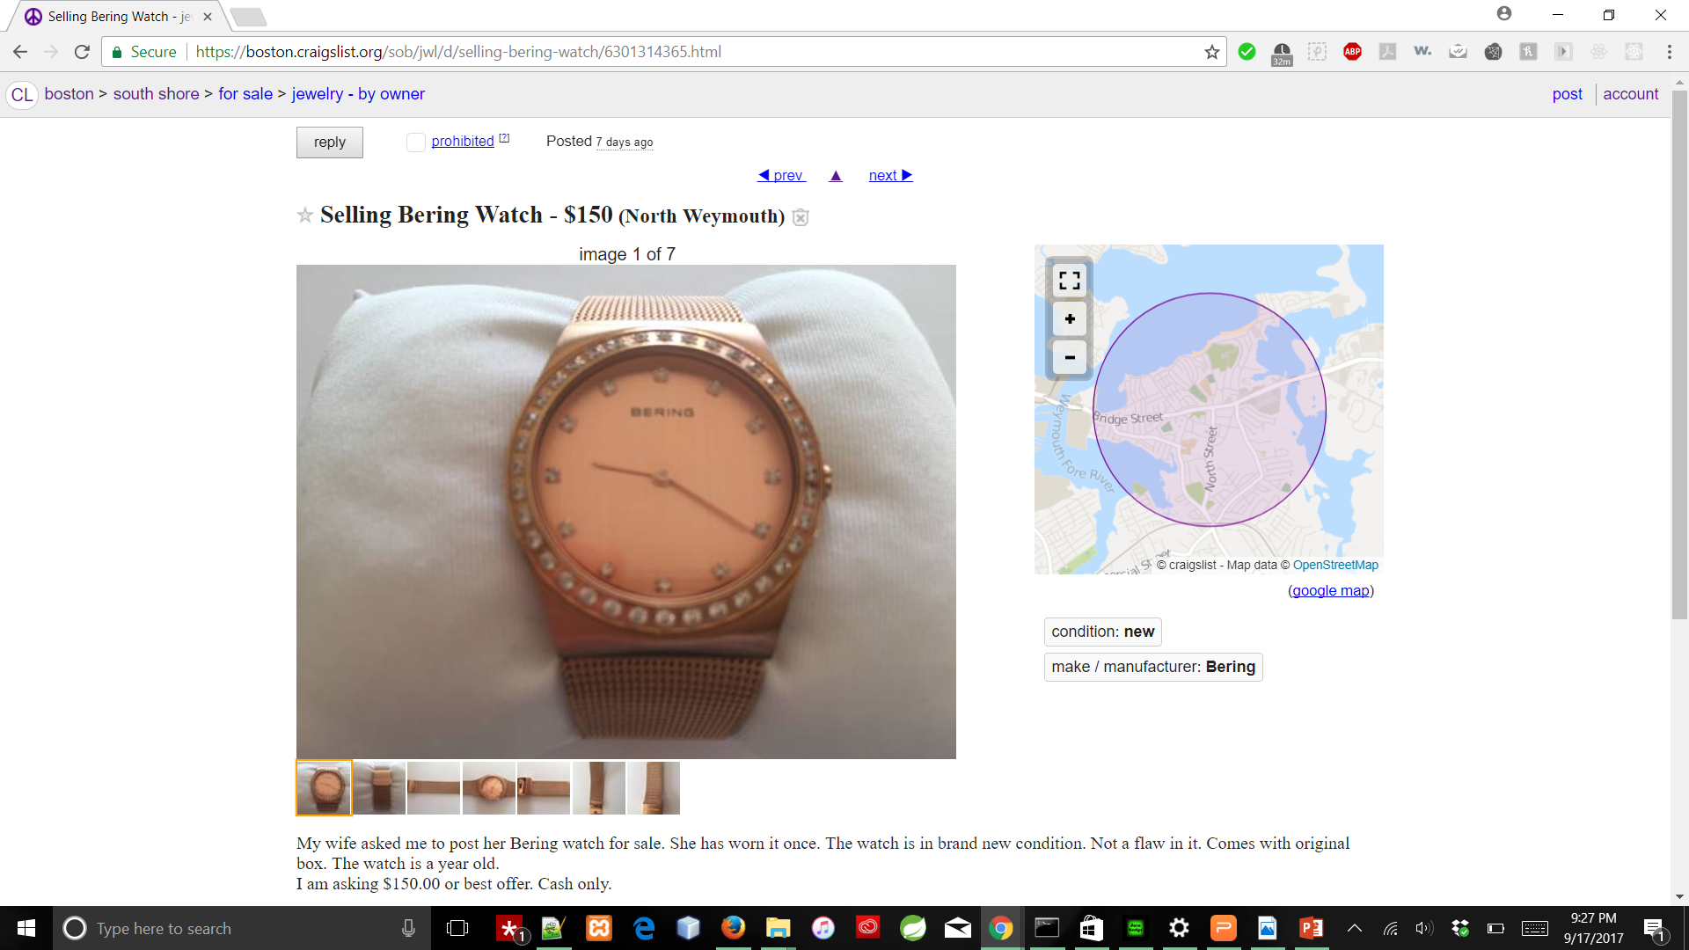
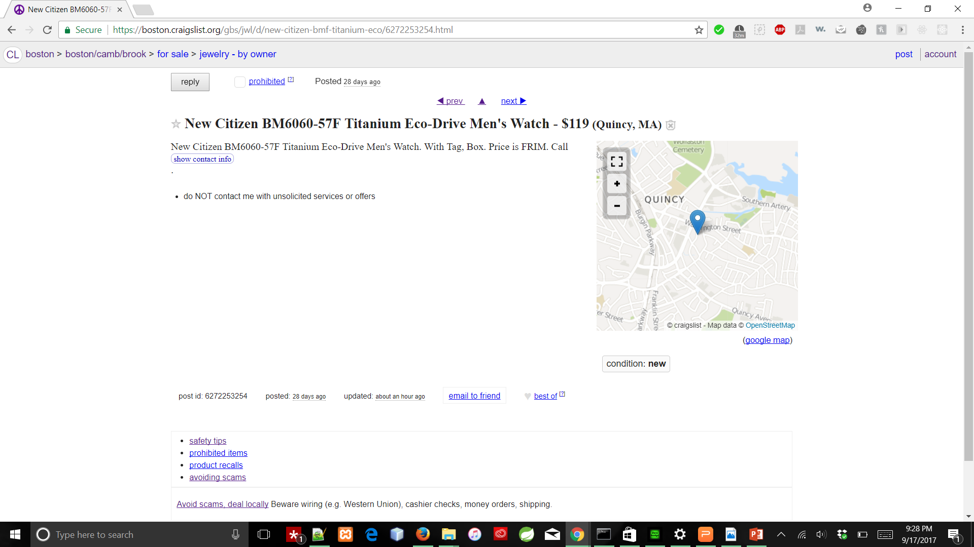
Inconsistency in Presentation of an ad:
Back to -
Notes:
The presentation of an ad lacks consistency.
It will be better if a “no image available for this post” image is presented to the user, if there is no image for that post.
The side thumbnails of images, instead of bottom, would make it even easier to go through the list of images available.

Slide 20
Back to -
Back

Slide 21
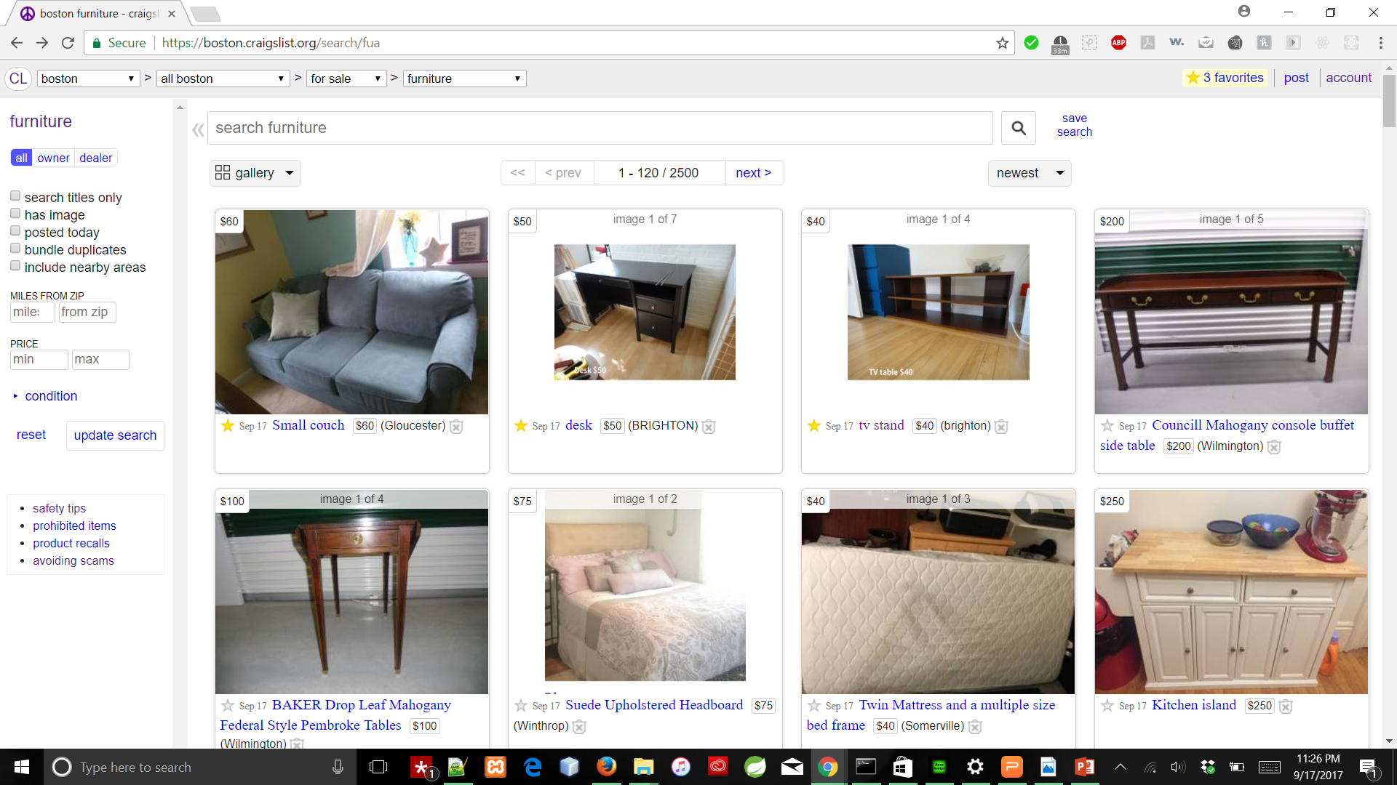
Favorites option:
Back
Back to -
Notes:
This option to save the items/posts the user likes is a nice feature. As there is no much scope for color contrast, use of Yellow for Favorites seems good but a bit brighter color/ color with greater bandwidth like orange would help users who are color-blind/ with less vision-support recognize the feature and use it often.

Slide 22
Improvements to overcome flaws and Overall Enhancements
Little More use of icons would improve usability
Display an “image not available” stating image wherever needed maintains consistency in design
Highlight the advanced search options would makes them more usable
Changing Color contrast for save option for a post to make it usable for customers with low vision support
Always showing the thumb nails of images of an ad for 0-n images
Adding a Carousal option for images of every post in the listings page would make customers to have quick view of the product before getting into other details
**Considering the goal of Craigslist, I have stated these improvements

Slide 23
Improvements to overcome flaws and Overall Enhancements: (Contd.)
Removing ambiguity in the links on the first page
Giving examples of an ideal password would help naïve users
Increasing the size of panel headings in the account homepage would make it clear to select
Rather than providing basic anchor elements, buttons or customized hyperlinks for Previous and Next ad links
A better alternative to present options to select region on the homepage, rather than titles for <a>s
Proper placement of buttons such as bestof, email to friend, reply dealer, show contact info would help in overall user experience
**Considering the goal of Craigslist, I have stated these improvements

Slide 24
Moonshot ideas:
Image and/or finger print as password
Pickup and service drones
Image recognition and suggest buying on craigslist

Slide 25

Notes:
Thank you for your time and attention ☺

